Slide 1


SELF COMPACTING CONCRETE
Mr. Y. S. Lanjewar
Assistant Professor
St. VINCENT PALLOTTI COLLEGE OF ENGINEERING &
TECHNOLOGY,NAGPUR
DEPARTMENT OF CIVIL ENGINEERING

Slide 2
Learning Outcomes
At the end of this session, you will be able to understand
The concept of Self Compacting Concrete (SCC)
Material Requirement for SCC
Application of SCC

Slide 3
Content
Introduction
History
Why Self Compacting Concrete?
Material Selection
The Requirements for SCC & Production
Test Methods for Compactibility
Application
Conclusion

Slide 4









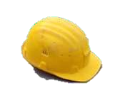
SCC is modern innovation- does not require vibration for placement and compaction.
Flowing consistency, High Performance, Uniform quality.
Most revolutionary development in concrete construction for several decades.

Slide 5
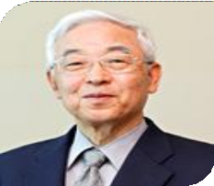
Introduction
Concrete that is able to flow and consolidate under its own weight, A special type of concrete of flowing consistency to obtain high performance, better and more reliable uniform quality.
Self- compacting concrete (SCC) developed by Proff. Hajime Okamura of University of Tokyo, Japan, in 1980`s

Slide 6
During his research, Okamura found that the main cause of the poor durability performances of Japanese concrete in structures was the inadequate compacting of the concrete in the casting operations.
By developing concrete that self- compacting, he eliminated the main cause for the poor durability performance of their concrete.

Slide 7
History of SCC
1983 | Concrete crisis in Japan, and concern for durability of concrete structures
1986 | Basic concept by Prof. H. Okamura of Tokyo University
1988 | Prototype for field experiments and implementations
1989 | Open experiment
1991 | Jt. Research project with construction companies
1993 | “High Performance Concrete” established
1994 | International Workshop on HPC in Bangkok
1997 | Technical Committee in RILEM

Slide 8
Why Self Compacting Concrete?
The existing concrete has faced criticism for its lower strength and difficult to obtain consistent quality.
Requirement of skilled worker for compaction in conventional concrete
Difficult to use mechanical compaction for
Underwater concreting
Cast in-situ pile foundation
Columns with congested reinforcement

Slide 9
Benefits of SCC
Faster Construction
Reduction in site manpower
Better surface finish
Easier placing
Improved durability
Greater freedom in design
Thinner concrete sections
Reduced noise level
Safer working environment

Slide 10


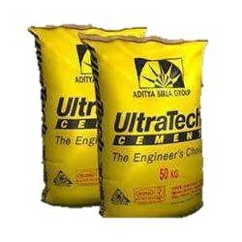
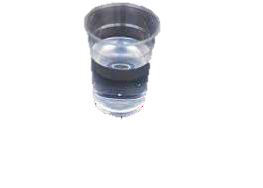

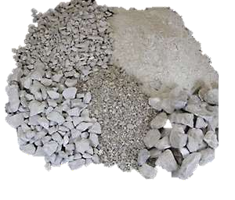

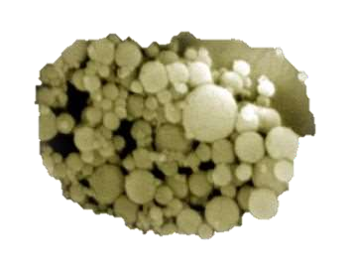

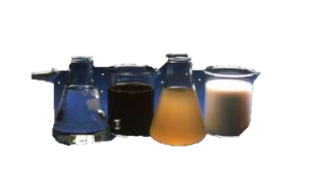
Materials Selection for SCC
Mixing Water
Cement
Aggregate
Chemical Admixture
Mineral Admixture

Slide 11
Material Selection
CEMENT
Ordinary Portland Cement of 43 or 53 grade can be used.
Coarse Aggregates
Crushed granite aggregate with nominal<12.5 mm and specific gravity 2.56.
Fine Aggregates
Zone-III sand passing through 4.75 mm sieve of specific gravity 2.56.
Chemical Admixtures
Superplasticizers provide necessary workability.
Viscosity Modifying Agents (VMA), provide stability.
Air entraining agents improve freeze-thaw resistance.

Slide 12
Mineral Admixtures
Fly Ash : Improve the quality and durability. Ground Granulated Blast Furnace Slag(GGBFS) Silica fume : Improve mechanical properties of SCC.
Stone powder : Finely crushed lime stone, dolomite or granite.
Fibres : Enhance the properties of SCC
Mixing Water
Ordinary potable water of pH ranging from 7 to 8.5.

Slide 13
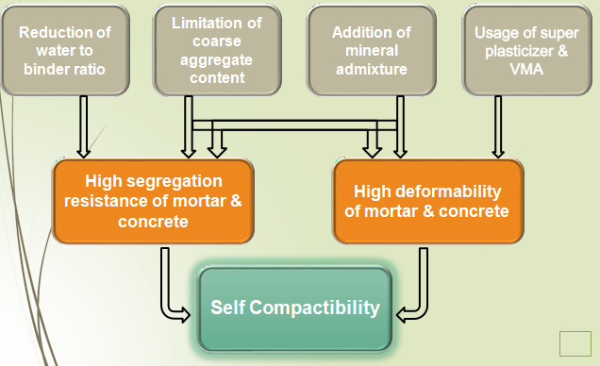
Flow Chart for achieving Self Compactibility…

Slide 14
Test Methods for Compactibility
Although many test methods have been developed for SCC but none has been standardised and the tests are not perfected.
Filling Ability
Slump flow test, T50 cm slump flow test, V-Funnel test
Passing ability
J-ring test, U-box, L-box
Segregation potential
Settlement column Test, Sieve stability test, Penetration test

Slide 15
Application
Two anchorages of Akashi-Kaikyo (Straits) Bridge, Japan. The volume of the cast concrete in the two anchorages amounted to 290,000 m3
The highest use of SCC in India was done at Delhi metro project. About 10000 m3 of SCC has been Used.
At Kaiga nuclear power plant, SCC of Characteristic
strength 30 MPa was used.

Slide 16
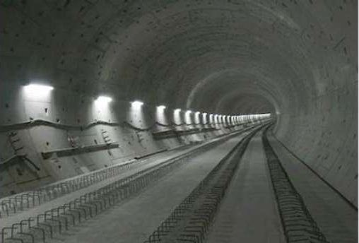
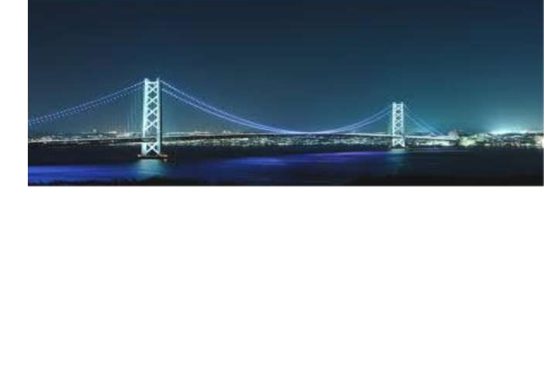
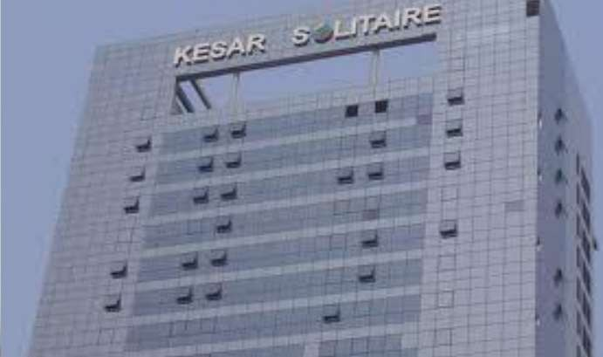
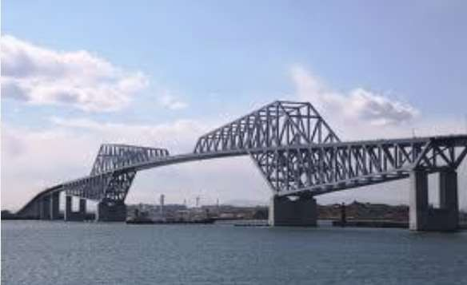
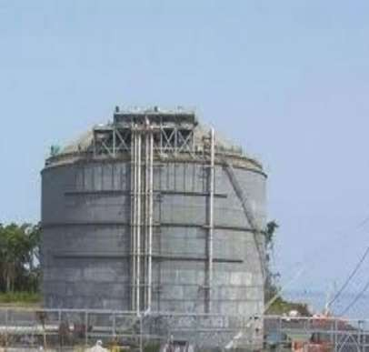

Slide 17
Conclusion
We can reduce the in-place cost and maker a safer
working environment for the workers.
SCC can be effectively placed in most congested areas and also where normal methods of vibration are not possible.
Further research are required to interpret influence on the hardened properties of SCC more precisely.
The cost of SCC is 10-15 % higher than the conventional concrete.

Slide 18


